Slide 1
Data Practices

Slide 2
Data Practices
An empirical view of what people creating, analyzing, and managing data actually do. (or would do)
so that we can improve efficiency and reliability
V1. Data Practices
V2: What’s going on in the lab?
V3: Data sharing
V4: Data Reuse
(how do we know what works?) (brace yourself; it ain’t pretty) (no, no, no, no, no. It’s mine!)
(if you didn’t make it, it is hard to use it)

Slide 3
V1. Data Practices
How do we know what works?
[The empirical science of data curation]
Empirical studies
Constructed, Naturalistic.
Data collection, data analysis

Slide 4
The empirical science of data curation
The science of data analytics is interdisciplinary (and partly social science)
but mostly mathematics
The science of data curation is interdisciplinary
(and partly mathematics)
but mostly social science
A fundamental question in the science of data curation is
How can we more efficiently and reliably support the use of data?
This is clearly an empirical question

Slide 5
The empirical science of data curation: How to we do it?
How can we more efficiently and reliably support the use of data?
To answer this question we must conduct empirical research.
We can divide empirical research in this area into two rough categories
Constructed studies
Naturalistic studies

Slide 6
Constructed studies
These typically follow the classic scientific model. . . conjecturing a hypothesis
and constructing an experiment or other targeted data collection to elicit confirmation.
Constructed studies are especially useful for
resolving an issue about what is influencing outcomes, determining how a particular intervention might affect outcomes, testing a new tool or practice.

Slide 7
Naturalistic studies
These typically collect data about an actual ongoing research situation, observing what researchers and their staff actually are doing,
and then using that data to develop theories about data curation,
or ideas for changes in practices.
[There may or may not be an hypothesis at the outset.]
Naturalistic studies can be useful for identifying problems and opportunities
or developing general picture of a research and data management practices in a field.

Slide 8
Methods
Data collection methods in empirical studies of research and data curation processes include:
interviews, surveys, transaction log analysis, work product analysis (code, data, workflow) time and motion studies, experiments, simulations, and so on.
Analytical methods in empirical studies of research and data curation processes include
mathematics, qualitative analysis, interpretative methods, often informed by theories and results in computer science, information science, and cognitive science.

Slide 9
References (General)
Ball, A. (2010). Data lifecycles. In Review of the State of the Art of the Digital Curation of Research Data. Project Report. Bath, UK: University of Bath. Borgman, C.L. (2012). The conundrum of sharing research data. Journal of the American Society for Information Science & Technology, 63(6): 1059-1078. Babeu, A. (2011). “Rome Wasn’t Digitized in a Day”: Building a Cyberinfrastructure for Digital Classics. Washington DC.
Chao, T. C., Cragin, M. H., & Palmer, C. L. (2014). Data Practices and Curation Vocabulary (DPCVocab): An empirically derived framework of scientific data practices and curatorial processes. JASIST.
Hanson, K., Surkis, A., & Yacobucci, K. (2012). Data Sharing and Management Snafu in 3 Short Acts [video]. Hey, A. J., Tansley, S., & Tolle, K. M. (2009). The fourth paradigm: data-intensive scientific discovery.
Cragin, M.H., Palmer, C.L., Carlson, J.R., & Witt, M. (2010). Data sharing, small science, and institutional repositories. Philosophical Transactions of the Royal Society A, 368(1926), 4023-4038.
Pepe, A., Goodman, A., Muench, A., Crosas, M. & Erdmann, C. (2014). How Do Astronomers Share Data? Reliability and Persistence of Datasets Linked in AAS Publications and a Qualitative Study of Data Practices among US Astronomers. PLoS ONE, 9(8): e104798.
Research Information Network. (2008). To Share or Not to Share: Publication and Quality Assurance of Research Data Outputs.
Tenopir, C., Allard, S., Douglass, K., Aydinoglu, A. U., Wu, L., Read, E., Manoff, M., et al. (2011). Data sharing by scientists: Practices and perceptions. PloS ONE, 6(6), e21101.
Tenopir C, Dalton ED, Allard S, Frame M, Pjesivac I, Birch B, et al. (2015) Changes in Data Sharing and Data Reuse Practices and Perceptions among Scientists Worldwide.
9

Slide 10
Data Practices
An empirical view of what people creating, analyzing, and managing data actually do. (or would do)
so that we can improve efficiency and reliability
V1. Data Practices
V2: What’s going on in the lab?
V3: Data sharing
V4: Data Reuse
(how do we know what works?) (brace yourself; it ain’t pretty) (no, no, no, no, no. It’s mine!)
(if you didn’t make it, it is hard to use it)

Slide 11
V2: What’s going on in the lab?
Empirical extraction of vocabulary and processes Empirical identification of bad behavior:
metadata?? (for retrieval? use? interpretation? preservation? credit? reproducibility?)
code documentation?
code testing?
workflow documentation?
provenance availability?
and so on
Incentives to do better?
The problem (we’re human, all too human)

Slide 12
Quasi-empirical studies
Much of the global analysis of research processes, data lifecycles, and data curation is
basically empirical,
but at the same time casual, not rigorous
That does mean it is wrong;
on the contrary: we don’t always need a rigorous designed study
For instance:

Slide 13
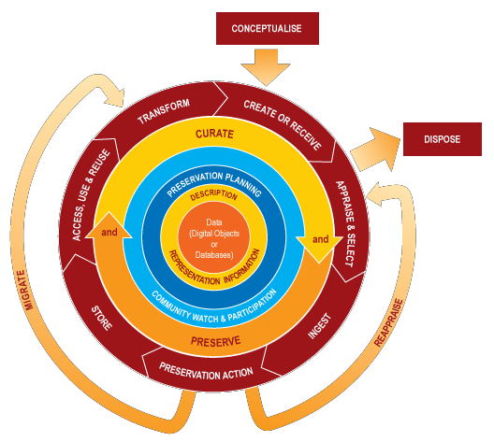
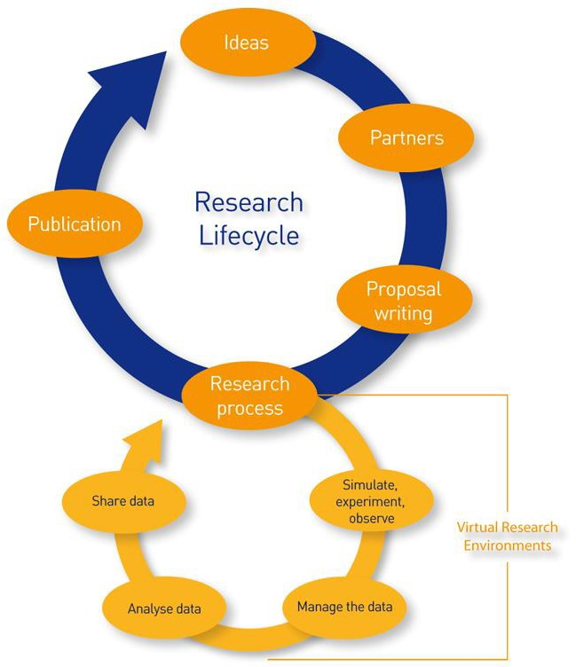
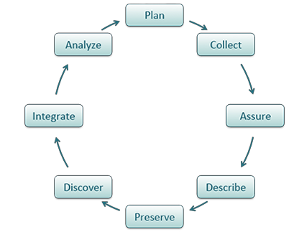
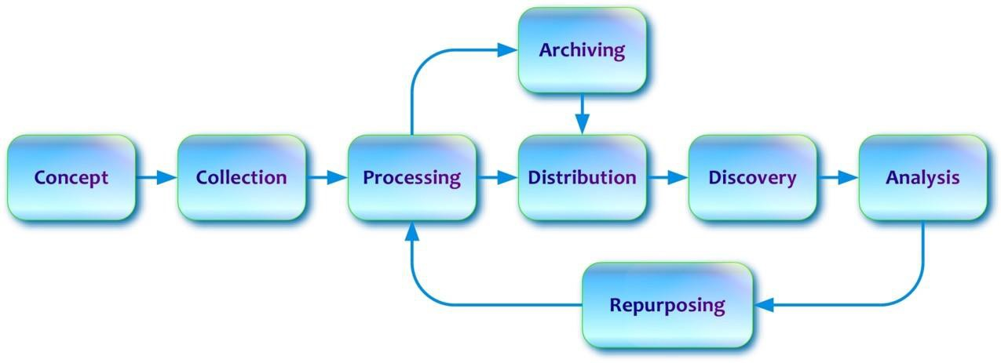
JISC/VRE Lifecycle
DCC Lifecycle
DataOne Lifecycle
5
DDI Data Lifecycle
Data Documentation Initiative. http://www.ddialliance.org/training/why-use-ddi DataONE. https://www.dataone.org/data-life-cycle
JISC/VRE: https://www.jisc.ac.uk/full-guide/implementing-a-virtual-research-environment-vre

Slide 14
An empirically derived typology of research data practices
Designing research Managing data Generating and collecting Processing
Analyzing, interpreting, and abstracting Representing data
Sharing data and products Attributing and citing data Publishing data
Chao, T. C., Cragin, M. H., & Palmer, C. L. (2014). Data Practices and Curation Vocabulary (DPCVocab): An empirically derived framework of scientific data practices and curatorial processes. JASIST.
6

Slide 15
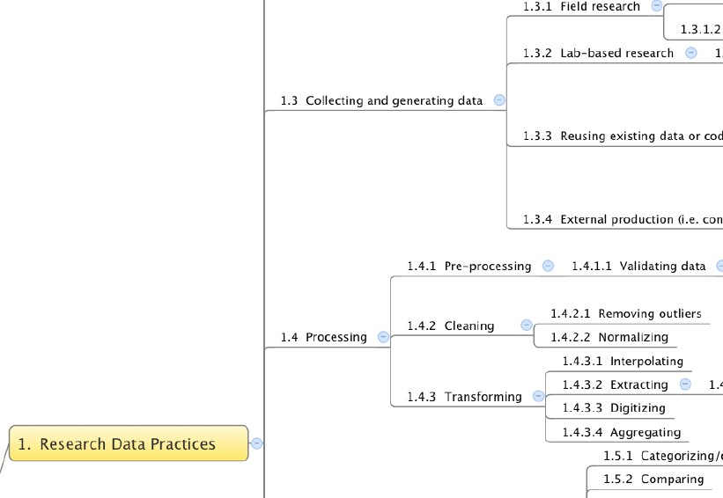
A fragment of an empirically derived “data practices and curation vocabulary” (DPCVocab)
Chao, T. C., Cragin, M. H., & Palmer, C. L. (2014). Data Practices and Curation Vocabulary (DPCVocab): An empirically derived framework of scientific data practices and curatorial processes. JASIST. DOI: 10.1002/asi.

Slide 16

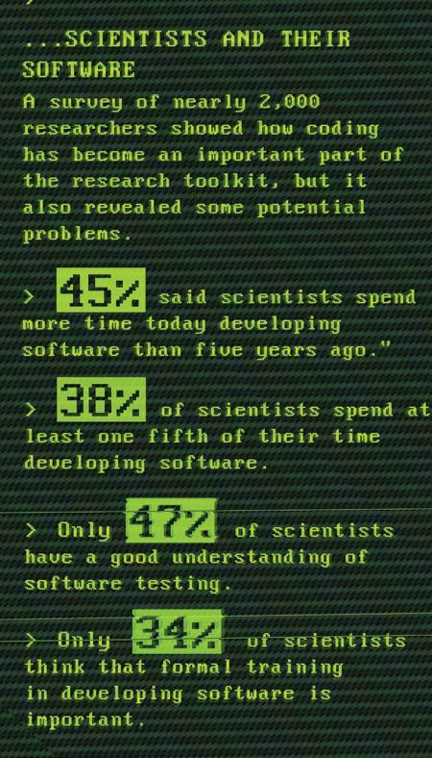
Discovering (ok, confirming) bad behavior
"As a general rule, researchers do not test or document their programs rigorously, and they rarely release their code, making it almost impossible to reproduce and verify published results generated by scientific software, say computer scientists. ... scientists often lack these communication and documentation skills”
— Zeya Merali “Computational science: ...Error . Why scientific programming does not compute”
Nature news feature (2010);
http://www.nature.com/news/2010/101013/full/467775a.html

Slide 17
Metadata failures
What metadata do you currently use to describe your data, if any?
Standards | 2014 Responses
DC (Dublin Core) | 7.1%
DwC (Darwin Core) | 2.0%
DIF (Directory Interchange Format) | 1.7%
EML (Ecological Metadata Language) | 9.3%
FGDC (Federal Geographic Data Committee) | 8.5%
ISO 19115 (Geographic Information-Metadata) | 10.2%
OGIS (Open GIS) | 7.2%
Standard within my lab | 16.7%
Other | 8.6%
None:
47.9%
(Tenopir et al., 2014)
9

Slide 18
Data storage
How much of your data do you currently store in the following locations?
 | Most or all of my data
External hard disk/drive storage | 83.3%
On my personal computer | 65.3%
Dropbox/Google/Figshare/Cloud | 57.2%
On my institution’s server | 37.7%
On the PI’s server | 28.4%
On a departmental server | 23.1%
On paper in my office | 13.7%
In my institution’s repository | 11.3%
In a domain repository | 9.5%
Other data repository or archive | 9.3%
In a publisher repository | 2.4%
(Tenopir et ala., 2014)
10

Slide 19
Why is it so hard to be good?
We don’t need a behavioral economist
to tell us that we have have a hard time giving up short-term benefits for long-term benefits, even when the long-term benefits are greater.
And that’s when the benefits accrue to ourselves (our future selves). How much harder it is when much of the benefit accrues to others
This is why we don’t document code, test our code, add metadata to datasets, use standards, backup our files, avoid transformations at the command line, etc. etc.
Often the benefits seems indirect and elusive, and we can convince ourselves it is unnecessary
[“No time to document this, but no need either: how it works is self-evident.
And no need to test it: we were careful.
And no need to back up an earlier version; this one is better,
and I don’t think we used that earlier version for anything important . . . (or did we?)”]

Slide 20
Incentives for good data practices …?
Scientific value
Better analysis and research outcomes
Credit
Credit for data producers (metadata)
Data sharing = increased citations (Pinowar, 2007)
Infrastructure
Interoperable applications, systems, and data Reliability and reproducibility
Efficiency
Easier collaboration
Tenure and promotion assessment
Measure of being a good data steward
???
12

Slide 21
References (General)
Ball, A. (2010). Data lifecycles. In Review of the State of the Art of the Digital Curation of Research Data. Project Report. Bath, UK: University of Bath. Borgman, C.L. (2012). The conundrum of sharing research data. Journal of the American Society for Information Science & Technology, 63(6): 1059-1078. Babeu, A. (2011). “Rome Wasn’t Digitized in a Day”: Building a Cyberinfrastructure for Digital Classics. Washington DC.
Chao, T. C., Cragin, M. H., & Palmer, C. L. (2014). Data Practices and Curation Vocabulary (DPCVocab): An empirically derived framework of scientific data practices and curatorial processes. JASIST.
Hanson, K., Surkis, A., & Yacobucci, K. (2012). Data Sharing and Management Snafu in 3 Short Acts [video]. Hey, A. J., Tansley, S., & Tolle, K. M. (2009). The fourth paradigm: data-intensive scientific discovery.
Cragin, M.H., Palmer, C.L., Carlson, J.R., & Witt, M. (2010). Data sharing, small science, and institutional repositories. Philosophical Transactions of the Royal Society A, 368(1926), 4023-4038.
Pepe, A., Goodman, A., Muench, A., Crosas, M. & Erdmann, C. (2014). How Do Astronomers Share Data? Reliability and Persistence of Datasets Linked in AAS Publications and a Qualitative Study of Data Practices among US Astronomers. PLoS ONE, 9(8): e104798.
Research Information Network. (2008). To Share or Not to Share: Publication and Quality Assurance of Research Data Outputs.
Tenopir, C., Allard, S., Douglass, K., Aydinoglu, A. U., Wu, L., Read, E., Manoff, M., et al. (2011). Data sharing by scientists: Practices and perceptions. PloS ONE, 6(6), e21101.
Tenopir C, Dalton ED, Allard S, Frame M, Pjesivac I, Birch B, et al. (2015) Changes in Data Sharing and Data Reuse Practices and Perceptions among Scientists Worldwide.
13

Slide 22
References (Lifecycle models)
Ball, A. (2010). Data lifecycles. In Review of the State of the Art of the Digital Curation of Research Data. Project Report. Bath, UK: University of Bath.
DataONE. Data Lifecycle Model. https://www.dataone.org/data-life-cycle
Digital Curation Centre. DCC Curation Lifecycle Model. http://www.dcc.ac.uk/resources/curation-lifecycle-model ICPSR. (2012). Guide to Social Science Data Preparation and Archiving. 5th Edition.
https://www.icpsr.umich.edu/icpsrweb/content/deposit/guide/
UCF Libraries. Resarch Lifecycle. http://library.ucf.edu/about/departments/scholarly-communication/research-lifecycle/
UK Data Archive. Create and Manage Data – Research Data Lifecycle. http://data-archive.ac.uk/create-manage/life-cycle USGS. The Data Lifecycle. https://www2.usgs.gov/datamanagement/why-dm/lifecycleoverview.php
14

Slide 23
Data Practices
An empirical view of what people creating, analyzing, and managing data actually do. (or would do)
so that we can improve efficiency and reliability
V1. Data Practices
V2: What’s going on in the lab?
V3: Data sharing
V4: Data Reuse
(how do we know what works?) (brace yourself; it ain’t pretty) (no, no, no, no, no. It’s mine!)
(if you didn’t make it, it is hard to use it)

Slide 24
V3: Data sharing
Why data sharing is important
Why data sharing is hard Impediments to sharing Incentives?

Slide 25
Why is data sharing important
Good data is, course, important and valuable to communities beyond the developing community
And it is arduous, time-consuming, and expensive to develop
And often we need relevant data immediately (crisis informatics)
So failure to share creates lost opportunity and additional expense
And can have extremely serious consequences (consider data in medicine, engineering, etc.
or data needed to address a disaster, such as a hurricane)

Slide 26
Why data sharing is hard
On the receiving side there are of course the usual data integration difficulties: finding relevant data,
getting needed permissions and licenses,
and integrating data in different formats and description standards into the receiving system of applications tools and practices – and it much be correctly understood.
But we’ve already had a good look at these problems earlier, and we’ll be revisiting some of them again
in the next video, on data Reuse.
Here we focus on the sharing side, that is: why share?

Slide 27
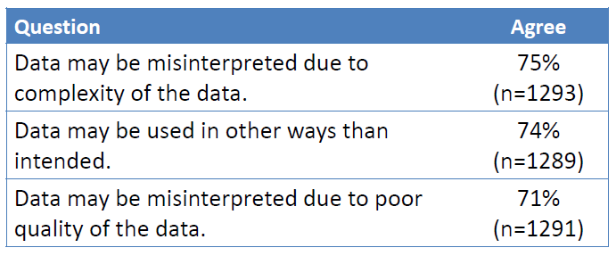
Data misuse concerns
(Tenopir et al., 2011)
6

Slide 28
More data sharing impediments
Astronomy (Gray et al)
Laborious process
Few standards
Science & Humanities (Borgman)
Laborious effort
No rewards for sharing data
Lose competitive advantage
Data ownership
Other challenges
Grant cycles & funding
Domains without repositories
Concerns of data misuse
Legal and ethical issues
Co-authorship expectations
(dis)incentives – tenure, promotion
(Cragin et al., 2010; Tenopir et al., 2011)
7

Slide 29
What we hear is not encouraging
Where’s the best place for my data?
My data’s available/archived on…[my computer, server, website]. Of course I’m willing to share my data, but...
My data will never be of use to anyone else. There are no standards in my field.
What version of the data should I share?
Raw vs. Processed, Continuously streaming data.
Researchers will need my special analysis tools to reuse the data.
8

Slide 30
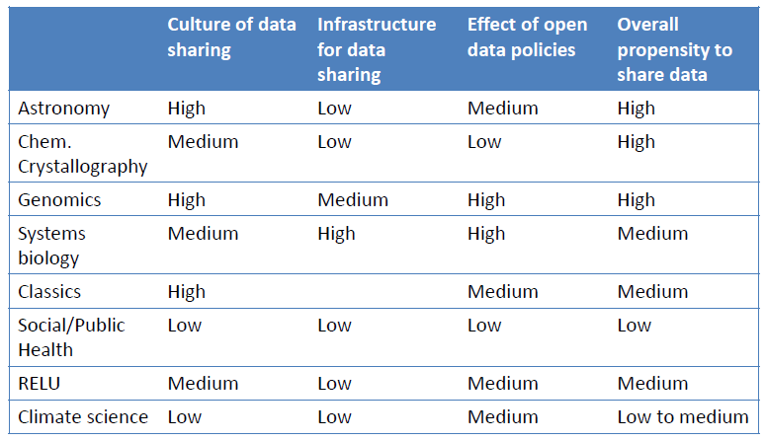
Sharing practices vary by discipline
Research Information Network (RIN), 2008
9

Slide 31
Incentives for sharing …?
Scientific value
Better analysis and research outcomes
Credit
Credit for data producers (metadata)
Data sharing = increased citations (Pinowar, 2007)
Infrastructure [this time from feedback] Interoperable applications, systems, and data Reliability and reproducibility
Efficiency
Easier collaboration
Reciprocity
You give some, you get some
Tenure and promotion assessment
Measure of being a good data steward
10

Slide 32
References (General)
Ball, A. (2010). Data lifecycles. In Review of the State of the Art of the Digital Curation of Research Data. Project Report. Bath, UK: University of Bath. Borgman, C.L. (2012). The conundrum of sharing research data. Journal of the American Society for Information Science & Technology, 63(6): 1059-1078. Babeu, A. (2011). “Rome Wasn’t Digitized in a Day”: Building a Cyberinfrastructure for Digital Classics. Washington DC.
Chao, T. C., Cragin, M. H., & Palmer, C. L. (2014). Data Practices and Curation Vocabulary (DPCVocab): An empirically derived framework of scientific data practices and curatorial processes. JASIST.
Hanson, K., Surkis, A., & Yacobucci, K. (2012). Data Sharing and Management Snafu in 3 Short Acts [video]. Hey, A. J., Tansley, S., & Tolle, K. M. (2009). The fourth paradigm: data-intensive scientific discovery.
Cragin, M.H., Palmer, C.L., Carlson, J.R., & Witt, M. (2010). Data sharing, small science, and institutional repositories. Philosophical Transactions of the Royal Society A, 368(1926), 4023-4038.
Pepe, A., Goodman, A., Muench, A., Crosas, M. & Erdmann, C. (2014). How Do Astronomers Share Data? Reliability and Persistence of Datasets Linked in AAS Publications and a Qualitative Study of Data Practices among US Astronomers. PLoS ONE, 9(8): e104798.
Research Information Network. (2008). To Share or Not to Share: Publication and Quality Assurance of Research Data Outputs.
Tenopir, C., Allard, S., Douglass, K., Aydinoglu, A. U., Wu, L., Read, E., Manoff, M., et al. (2011). Data sharing by scientists: Practices and perceptions. PloS ONE, 6(6), e21101.
Tenopir C, Dalton ED, Allard S, Frame M, Pjesivac I, Birch B, et al. (2015) Changes in Data Sharing and Data Reuse Practices and Perceptions among Scientists Worldwide.
11

Slide 33
Data Practices
An empirical view of what people creating, analyzing, and managing data actually do. (or would do)
so that we can improve efficiency and reliability
V1. Data Practices
V2: What’s going on in the lab?
V3: Data sharing
V4: Data Reuse
(how do we know what works?) (brace yourself; it ain’t pretty) (no, no, no, no, no. It’s mine!)
(if you didn’t make it, it is hard to use it)

Slide 34
V4: Data reuse
What is reuse and why is it important? reuse vs sharing
What are the obstacles to reuse?
How can reuse be supported?

Slide 35
Data reuse, what is it
“[data reuse is] …the use of data collected for one purpose to study a new problem.”
(Zimmerman, 2008)
And perhaps also:
the use of data collected by one technical community
and being used by another technical community”
And, most often, both of those apply:
Different communities and different problems
[and so: different methods, practices, vocabularies, software . . . etc.]
(Tenopir et al., 2014)
4

Slide 36
Reuse vs Sharing
Data sharing and data reuse are closely related, but a rough distinction can be drawn,
focusing on the perspective taken by research studies in this area.
Data sharing studies tend to focus on:
Why and how data producers share (or don’t share) their data
and how we can encourage and support data sharing
Data reuse studies tend to focus on:
How communities use (or why they don’t use) relevant data that they did not produce
and for which they are not the intended consumer*
and how we can encourage and support reliable and efficient reuse of such data
So data sharing focuses on the producer, and data reuse on the consumer.
Not surprisingly the respective issues tend to be mirror images.
*cf. “designated community” (OAIS).

Slide 37
Why data sharing ^{reuse} is important
Good data is, course, important and valuable to communities beyond the developing community
And it is arduous, time-consuming, and expensive to develop
And often we need relevant data immediately (crisis informatics)
So failure to share ^^{reuse} creates lost opportunity and additional expense
And can have extremely serious consequences (consider data in medicine, engineering, etc.
or data needed to address a disaster, such as a hurricane)

Slide 38
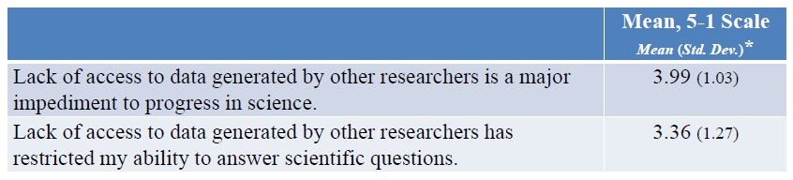
Some empirical data on consequences
* 1 = Strongly disagree to 5 = Strongly agree
(Tenopir et al., 2014)
7

Slide 39
Reuse challenges
Factors influencing reuse of a data set: Discovering the data
Assessing relevance
Serialization and file format issues logical and conceptual modeling issues
Semantic variations (vocabularies, definitions of terms, etc)
Trustworthiness (inputs, algorithms, provenance, workflow)
Intellectual property, credit, and regulatory issues
and more.
Obviously many of these are similar to data integration issues discussed earlier And, equally obvious:
On the supply side standards and documentation (especially metadata) are key to supporting reuse.
8

Slide 40
Area-specific challenges to data reuse (and sharing)
Medical, financial, social, governmental
Heavily regulated by federal and state statutes and common law. Major tort and statutory liabilities for violation.
Security requirements for allowed use may be unavailable and can be expensive.
and so on
Other for-profit industry (in addition to challenges above)
Data or data access may be revenue-generating business product.
Data has strategic value (or vulnerability) to unit
with negative consequences (even if greater social value) if public.
Even if data is available provenance and workflow (etc) information may be restricted, limiting value of data
Data circulation can trigger restraint of trade (e.g. price fixing, Sherman Antitrust Act).
Licensing violations can create substantial financial vulnerability.
and so on
9

Slide 41
References (General)
Ball, A. (2010). Data lifecycles. In Review of the State of the Art of the Digital Curation of Research Data. Project Report. Bath, UK: University of Bath. Borgman, C.L. (2012). The conundrum of sharing research data. Journal of the American Society for Information Science & Technology, 63(6): 1059-1078. Babeu, A. (2011). “Rome Wasn’t Digitized in a Day”: Building a Cyberinfrastructure for Digital Classics. Washington DC.
Chao, T. C., Cragin, M. H., & Palmer, C. L. (2014). Data Practices and Curation Vocabulary (DPCVocab): An empirically derived framework of scientific data practices and curatorial processes. JASIST.
Hanson, K., Surkis, A., & Yacobucci, K. (2012). Data Sharing and Management Snafu in 3 Short Acts [video]. Hey, A. J., Tansley, S., & Tolle, K. M. (2009). The fourth paradigm: data-intensive scientific discovery.
Cragin, M.H., Palmer, C.L., Carlson, J.R., & Witt, M. (2010). Data sharing, small science, and institutional repositories. Philosophical Transactions of the Royal Society A, 368(1926), 4023-4038.
Pepe, A., Goodman, A., Muench, A., Crosas, M. & Erdmann, C. (2014). How Do Astronomers Share Data? Reliability and Persistence of Datasets Linked in AAS Publications and a Qualitative Study of Data Practices among US Astronomers. PLoS ONE, 9(8): e104798.
Research Information Network. (2008). To Share or Not to Share: Publication and Quality Assurance of Research Data Outputs.
Tenopir, C., Allard, S., Douglass, K., Aydinoglu, A. U., Wu, L., Read, E., Manoff, M., et al. (2011). Data sharing by scientists: Practices and perceptions. PloS ONE, 6(6), e21101.
Tenopir C, Dalton ED, Allard S, Frame M, Pjesivac I, Birch B, et al. (2015) Changes in Data Sharing and Data Reuse Practices and Perceptions among Scientists Worldwide.
10

